Slide 1


Mocking and Integration Tests
Basics
QA
Automation
SoftUni Team
Technical Trainers
Software University
http://softuni.bg

Slide 2

Table of Contents
What is mocking ?
Why we need it ?
Mocking types
Mocks
Stubs
Fakes
Mocking Examples
Integration tests

Slide 3
Have a Question?
sli.do #QA-Automation

Slide 4
What is mocking
In a unit test, mock objects can simulate the behavior of complex, real objects and are therefore useful when a real object is impractical or impossible to incorporate into a unit test. If an object has any of the following characteristics (Wikipedia)
Mocking is primarily used in unit testing. An object under test may have dependencies on other (complex) objects. To isolate the behavior of the object you want to replace the other objects by mocks that simulate the behavior of the real objects. This is useful if the real objects are impractical to incorporate into the unit test.
In short, mocking is creating objects that simulate the behavior of real objects.

Slide 5
Why we need it ?
For objects where
the object supplies non-deterministic results (e.g. the current time or the current temperature);
it has states that are difficult to create or reproduce (e.g. a network error);
it is slow (e.g. a complete database, which would have to be initialized before the test);
it does not yet exist or may change behavior;
it would have to include information and methods exclusively for testing purposes (and not for its actual task).
For example, an alarm clock program which causes a bell to ring at a certain time might get the current time from a time service. To test this, the test must wait until the alarm time to know whether it has rung the bell correctly. If a mock time service is used in place of the real time service, it can be programmed to provide the bell-ringing time (or any other time) regardless of the real time, so that the alarm clock program can be tested in isolation.

Slide 6
Mocking types
Mocks, fakes, and stubs
Classification between mocks, fakes, and stubs is highly inconsistent across the literature. Consistent among the literature, though, is that they all represent a production object in a testing environment by exposing the same interface. Which out of mock, fake, or stub is the simplest is inconsistent, but the simplest always returns pre-arranged responses (as in a method stub). On the other side of the spectrum, the most complex object will fully simulate a production object with complete logic, exceptions, etc. Whether or not any of the mock, fake, or stub trio fits such a definition is, again, inconsistent across the literature. For example, a mock, fake, or stub method implementation between the two ends of the complexity spectrum might contain assertions to examine the context of each call. For example, a mock object might assert the order in which its methods are called, or assert consistency of data across method calls. In the book The Art of Unit Testing mocks are described as a fake object that helps decide whether a test failed or passed by verifying whether an interaction with an object occurred. Everything else is defined as a stub. In that book, fakes are anything that is not real, which, based on their usage, can be either stubs or mocks. (Wikipedia)

Slide 7
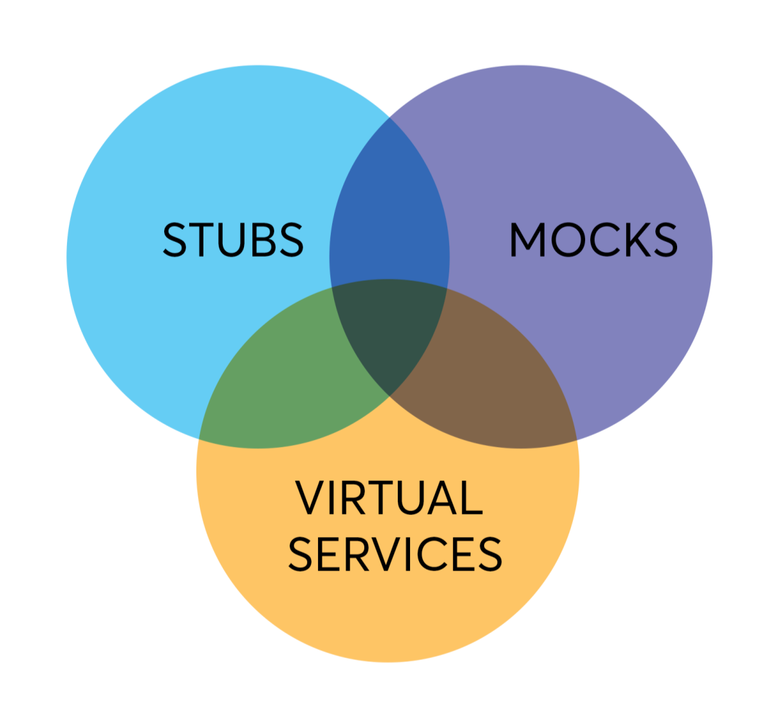
Mocking types

Slide 8
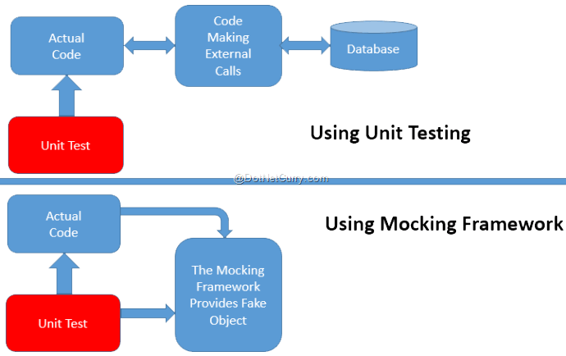
Example 1 – Database mocking
ASP.NET MVC Model Testing using NUnit and MOQ | DotNetCurry

Slide 9
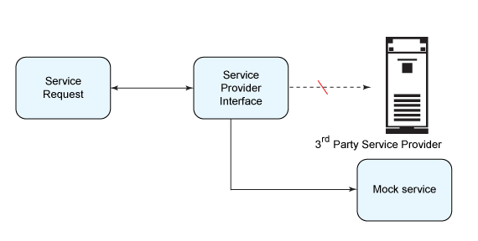
Example 2 – Service mocking

Slide 10
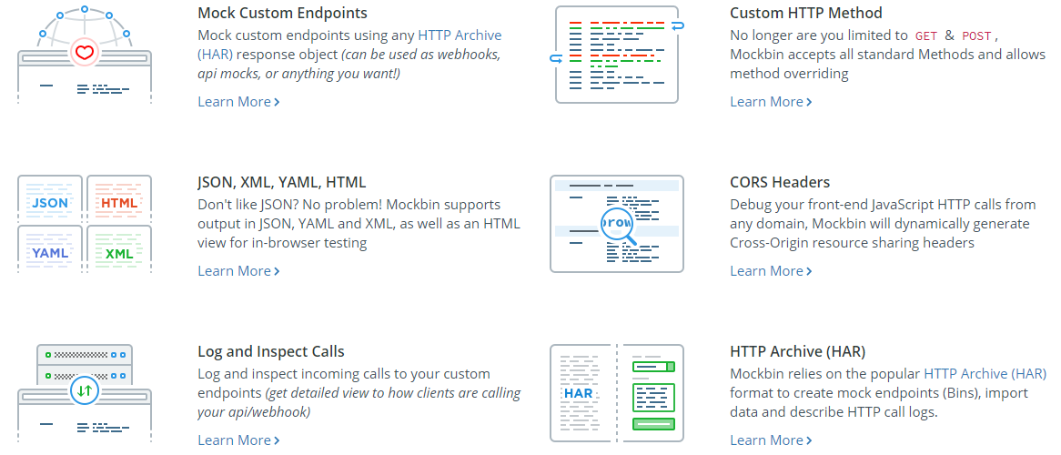
Example 3 – Web hook mocking
Mockbin.org

Slide 11
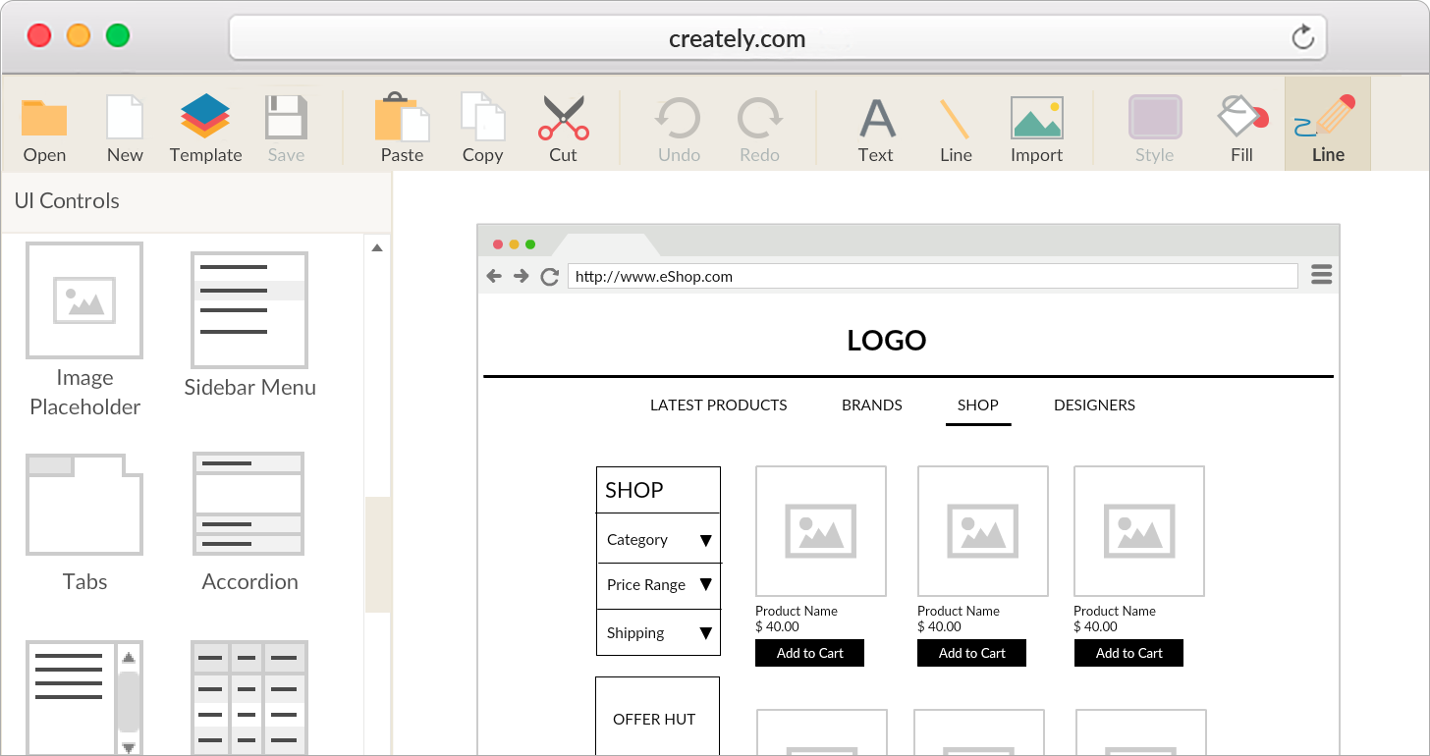
Example 4 – UI mocking

Slide 12
Real word example
See https://www.codeproject.com/Articles/30381/Introduction-to-Mocking

Slide 13
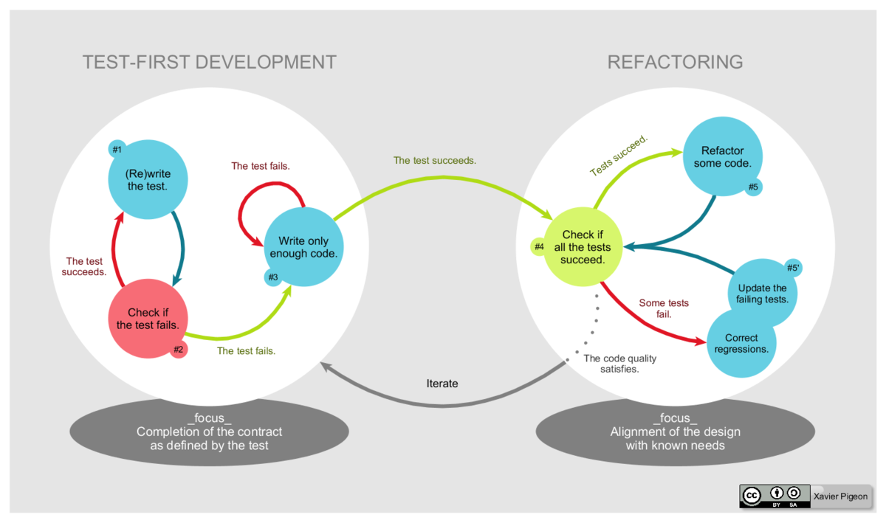
TDD
What is Test Driven Developmen (Test-Driven Development)

Slide 14
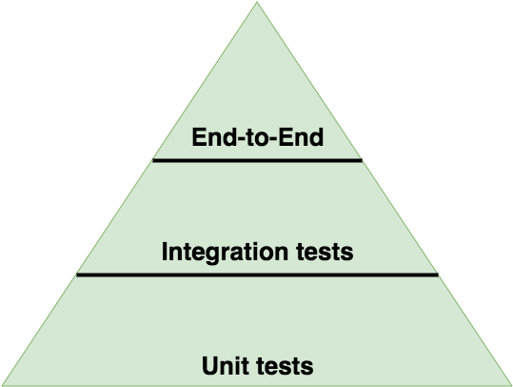
Integration tests

Slide 15
Integration tests in ASP.NET Core
https://docs.microsoft.com/en-us/aspnet/core/test/integration-tests?view=aspnetcore-2.1

Slide 16
How to write good integration tests
1. Consider the cost/benefit of each test
2. Use intention revealing test names
3. Use your public API as much as possible
4. Create a new API when one isn’t available
5. Use the same UI as your customers
6. Use command line parameters for values that will change when tests are re-run
7. Test using all the same steps your customers will perform
8. Return your system under test to the original state
9. Listen to your customers and support team

Slide 17
When Creating Integration Tests Don’t…
1. Write an integration test when a unit test will suffice
2. Use anything that a customer cannot use
3. Access any part of the system directly
4. Use constants in the body of your tests
5. Create an internal only API
6. Create an internal only UI
7. Make your test too complex
8. Test more than one thing
9. Leave the test system in a bad/unknown state

Slide 18






SoftUni Diamond Partners

Slide 19






SoftUni Diamond Partners

Slide 21

License
This course (slides, examples, demos, videos, homework, etc.) is licensed under the "Creative Commons Attribution-NonCommercial-ShareAlike 4.0 International" license

Slide 22




Trainings @ Software University (SoftUni)
Software University – High-Quality Education, Profession and Job for Software Developers
softuni.bg
Software University Foundation
http://softuni.foundation/
Software University @ Facebook
facebook.com/SoftwareUniversity
Software University Forums
forum.softuni.bg

